Slide 1


Image Caption Generator using CNN-LSTM from Scratch
Course: EC9170
Presented by: 2021/E/170
2021/E/054
2021/E/023

Slide 2
Project Overview
Objective:
To generate descriptive captions for input images using a deep learning model built from scratch, combining vision and language understanding.
Technologies Used:
CNN: InceptionV3 (pre-trained on ImageNet) for image feature extraction
LSTM: Long Short-Term Memory for sequence generation
Keras, TensorFlow, Keras Tuner, NumPy, Pickle
Dataset Summary:
8,091 real-world images (.jpg)
5 human-written captions per image
Split: 70% Training, 15% Validation, 15% Testing

Slide 3
Methodology & Data Preprocessing
Main Workflow:
Data Preprocessing → Feature Extraction → Sequence Generation → Model Training → Evaluation
1. Data Preprocessing
Captions : Cleaned, lowercased, and wrapped with "startseq","endseq"/Tokenized, padded
Dataset Split : Shuffled and split: 70% Train, 15% Validation, 15% Test
2. Feature Extraction
Image Processing : Resized to 299x299 pixels / Normalized with preprocess_input()
Feature Generation : Extracted 2048-dim vectors from InceptionV3 / Saved to custom_image_features.pkl
3. Sequence Generation
Merged image features with partial captions
Created (input_image, input_sequence, output_word) triplets
Saved to .npy for training reuse

Slide 4

Model Architecture
CNN-LSTM Hybrid:
Image Branch : Input(2048) → Dropout(0.5) → Dense(256)
Caption Branch : Input(maxlen) → Embedding(vocab_size, 256) → Dropout(0.5) → LSTM(256)
Fusion : add([Image, LSTM]) → Dense(256) → Dense(vocab_size, softmax)
Training Configuration:
Loss: Sparse Categorical Crossentropy
Optimizer: Adam (LR = 0.001)
Batch Size: 64
Epochs: 20 (early stopped at best val_loss)
Callbacks:
ModelCheckpoint: saves best model
EarlyStopping: patience = 5 epochs

Slide 5
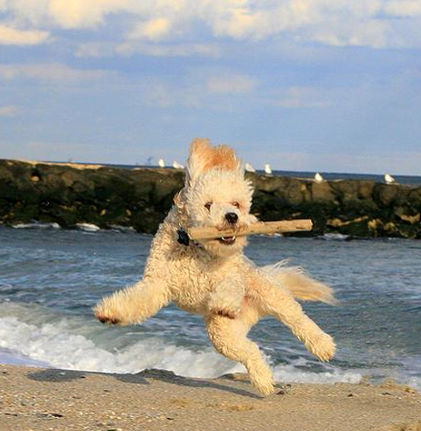
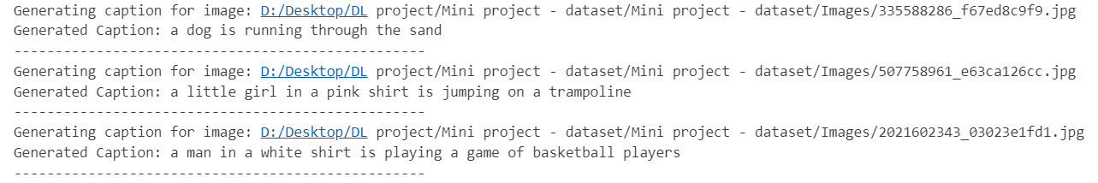
Results & Evaluation
Performance Metrics:
Test Accuracy: 38.4%
Test Loss: 3.44
Val Accuracy (CV): ~39.6%
Sample Predictions:

Slide 6
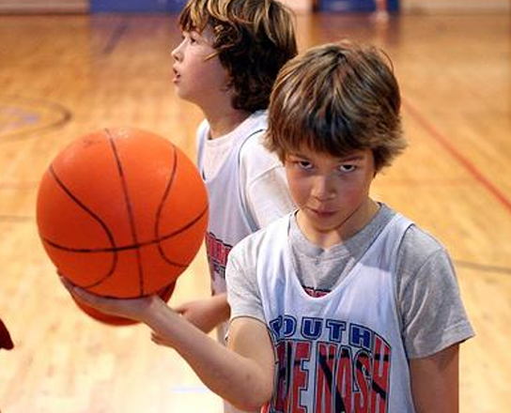
Optimization Strategy:
Keras Tuner:
Tuned: dropout_rate, lstm_units, learning_rate
Cross-Validation:
2-fold CV on training subset
Ensured generalization and prevented overfitting

Slide 7

Thank You!

